Slide 1


Slide 2

Leader- Siddhesh Salve
Members-
Prateek Das
Prabhat Dutta

Slide 3
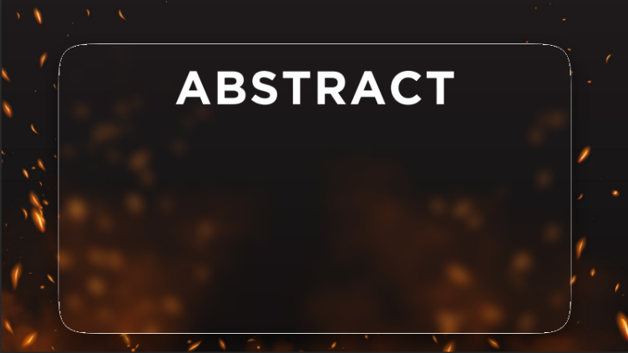
Appliance Control and Automation:
Smart Plugs and Switches
b) Usage Pattern Learning
c) Automated Energy Optimization
d) Personalized Energy Profiles
e) Mobile and Voice Control

Slide 4

Google Home
Amazon Alexa

Slide 5

Database management
UI/UX design
IOT Devices and Sensors
Machine learning and Deep learning
Web or Mobile Applications

